Slide 1
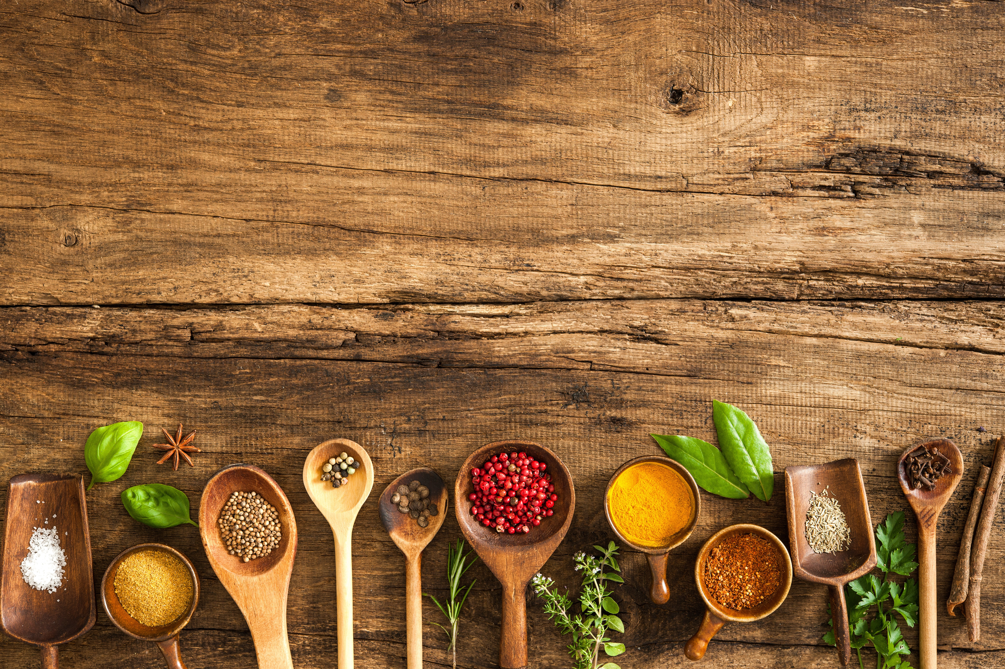


G.ro.me
Grocery shopping day
04/ 14 / 17, Thursday
Go

Slide 2










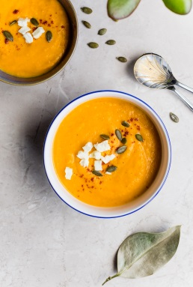
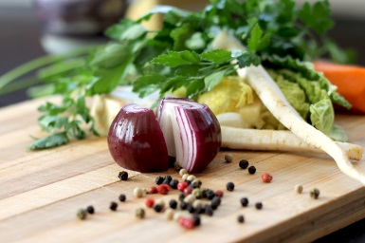
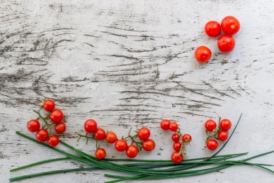
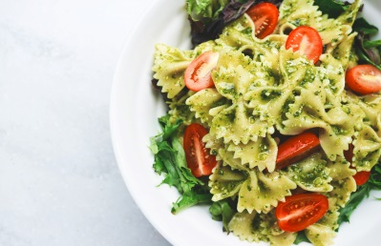
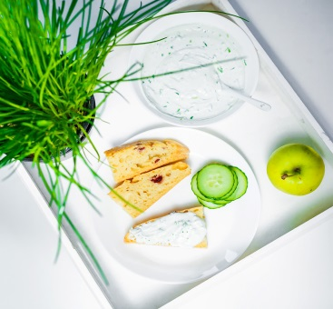
Web page title
http://www.url.com
G.ro.me
Apr 14 – 20, 2017
Navigate
Weekly
Today
Save
Select Dishes
 | Meal # | Fri 4/14 | Sat 4/15 | Sun 4/16 | Mon 4/17 | Tue 4/18 | Wed 4/19 | Thur 4/20
 | Meal #1
 | Meal #2
 | Meal #3
Breakfast
Lunch
Dinner
Sweet Corn Soup
Dal
Sauted Veg
Empty grid rendered for week starting from the selected ‘StartDate’
Tomatoe Soup
Red Sauce Pasta
Dabeli
Pav Bhaji
Accordians for Breakfast, Lunch and Dinner loaded with respective dishes.
Strategy ok for short term. Will need to think of a way to get a subset of dishes and load additional dishes on demand, but that’s for future

Slide 3

Web page title
http://www.url.com
G.ro.me
Apr 14 – 20, 2017
Navigate
Weekly
Today
Save
Select Dishes
 | Meal # | Fri 4/14 | Sat 4/15 | Sun 4/16 | Mon 4/17 | Tue 4/18 | Wed 4/19 | Thur 4/20
 | Meal #1
 | Meal #2
 | Meal #3
Breakfast
Oatmeal
Poha
Sandwich
Oatmeal
Upma
Bagaani
Oatmeal
Oatmeal
Dhokla
Sevaiyan
Oatmeal
Oatmeal
Oatmeal
Oatmeal
Lunch
Banana
Dinner
Oatmeal
Sweet Corn Soup
Dal Rice
Palak
Paneer
Eat out
Bhindi
Poriyal
Ghia
Aaloo Burji
Dal
Sweet Corn Soup
Tomatoe Soup
Pasta
Oatmeal
Dal
Sauted Veg.
Oatmeal
Oatmeal
Dal
Dabeli
Sauted Veg
Oatmeal
Oatmeal
Oatmeal
Oatmeal
Tomatoe Soup
Grid populated with dishes.
Multiple dishes may be added to each meal/day
Double clicking on a cell in the grid should result in the addition of ‘Eat out’ (client-side)
Red Sauce Pasta
Dabeli
Pav Bhaji
Static images for slight aesthetics

Slide 4

Web page title
http://www.url.com
G.ro.me
Apr 14 – 20, 2017
Diners
2
Save
Generated List
Miscellaneous List
# | Item | Qty
1 | Tomato | 10
2 | Potato | 15
3 | Bell Pepper | 6
4 | Carrots | 9
5 | Spinach | 2
6 | Beetroot | 2
7 | Onion | 8
# | Item | Qty
1 | Bread | 1
2 | Milk | 1
3 | Letils | 1 pack
4 | Rice | 10 lbs
5 | Ice Cream
Miscellaneous list to capture additional items

